Slide 1
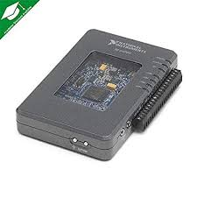
COLOR SORTING MACHINE
USING MY RIO AND
IMAGE PROCESSING
SUBMITTED BY
P.SUMANTH

Slide 2

CONTENTS
ABSTRACT
INTRODUCTION
NECESSARY EQUIPMENT
DESIGN AND CONSTRUCTION
MY RIO OVER AURDINO?
APPLICATIONS
CONCLUSION
REFERENCES

Slide 3
ABSTRACT
For sorting object in industry optical sorting is very much convenient. Color and size are the most important features for accurate classification and sorting of product which can be done by using some optical sensors or analyzing their pictures. The color sorting machine is mainly a device that can sense the different color of the object and assert them into different belt conveyor. The color detecting sensors worked well and it was able to detect red or green object quite nicely and change the direction of servo on right and left side to sort the object in proper place

Slide 4
INTRODUCTION
Machines can perform highly repetitive tasks better than humans. An employee who has been performing an inspection task over and over again may eventually fail to recognize the color of product. Automating many of the tasks in the industries may help to improve the efficiency of manufacturing system. The purpose of this model is to design and implement a system which automatically separates products based on their color. This machine consists of three parts: conveyor belt, color sensor or Image Processing module , and dc motor. The output and input of these parts was interfaced using MY RIO

Slide 5
NECESSARY EQUIPMENT
Two Servo motors
And Web Cam
One Conveyer Belts
My RIO
Image Processing module
Breadboard and jump wires
Battery Eliminator
Power jack

Slide 6
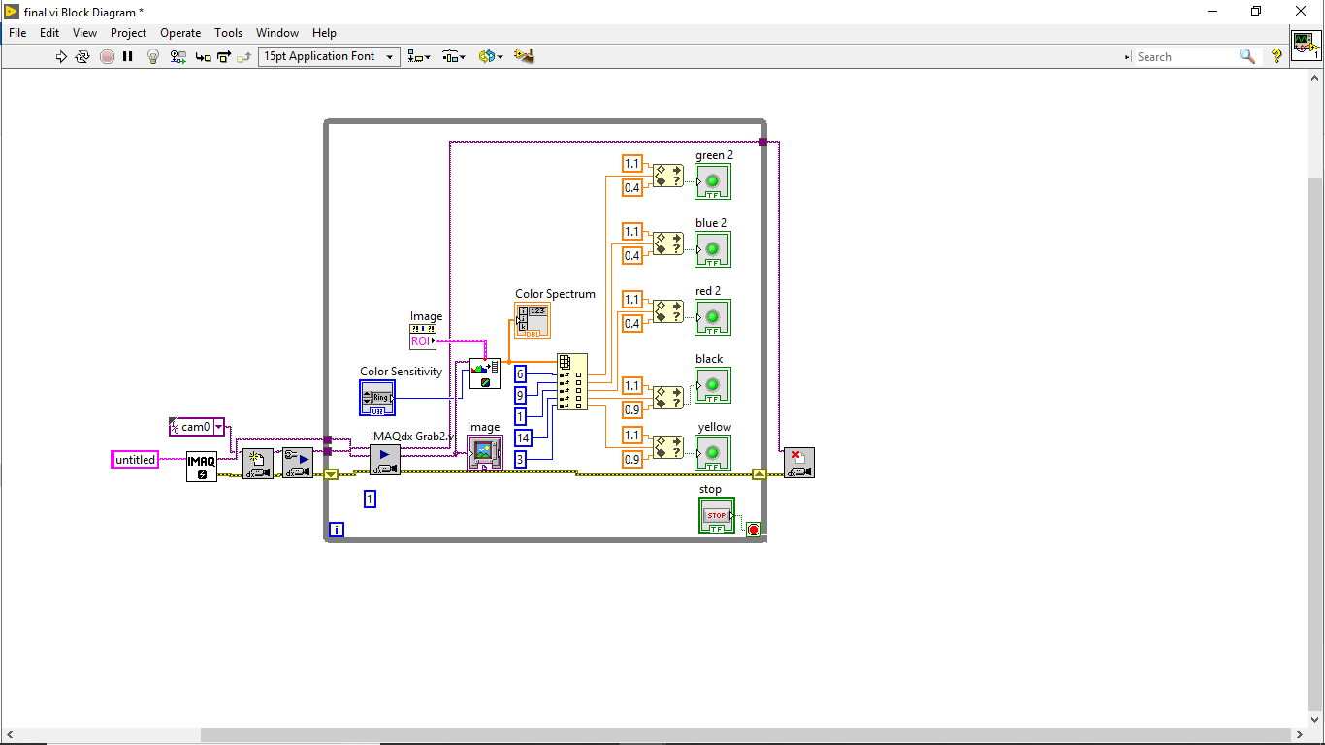
Image Processing Module Used For Determing Color Of An Object

Slide 7
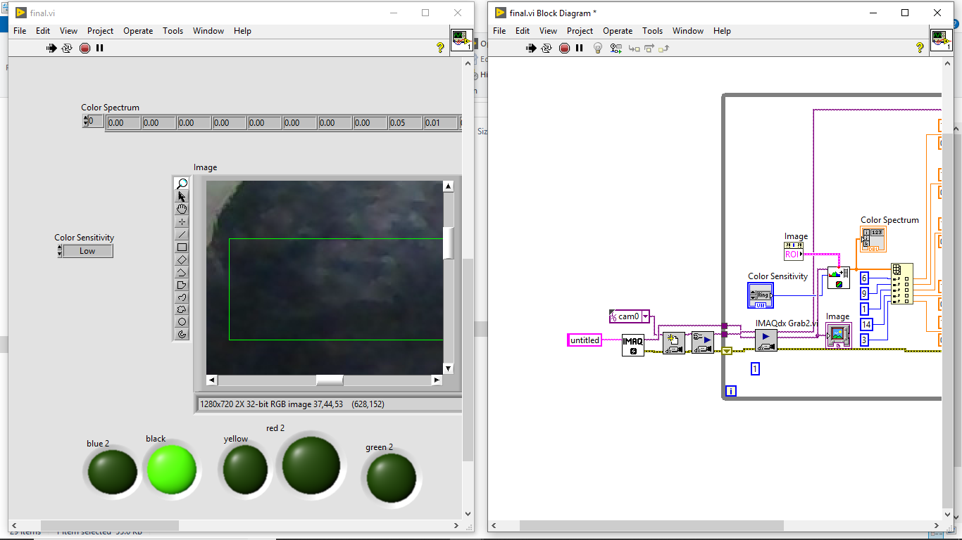
Detecting Black And Led (Black) Is ON

Slide 8
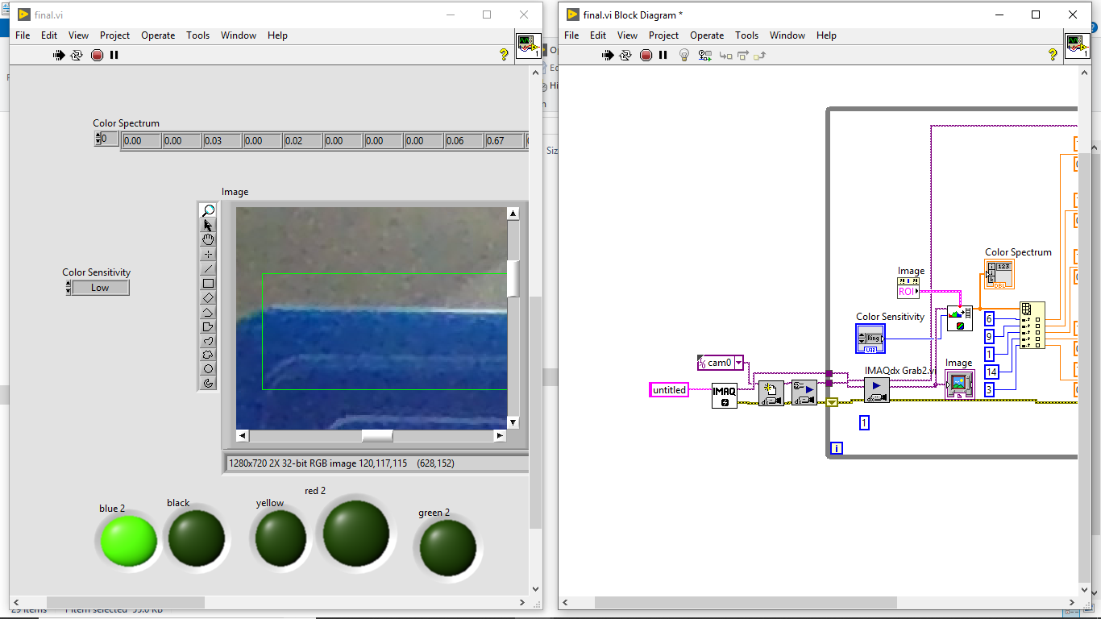
Detecting Blue And Led (Blue) Is ON

Slide 9
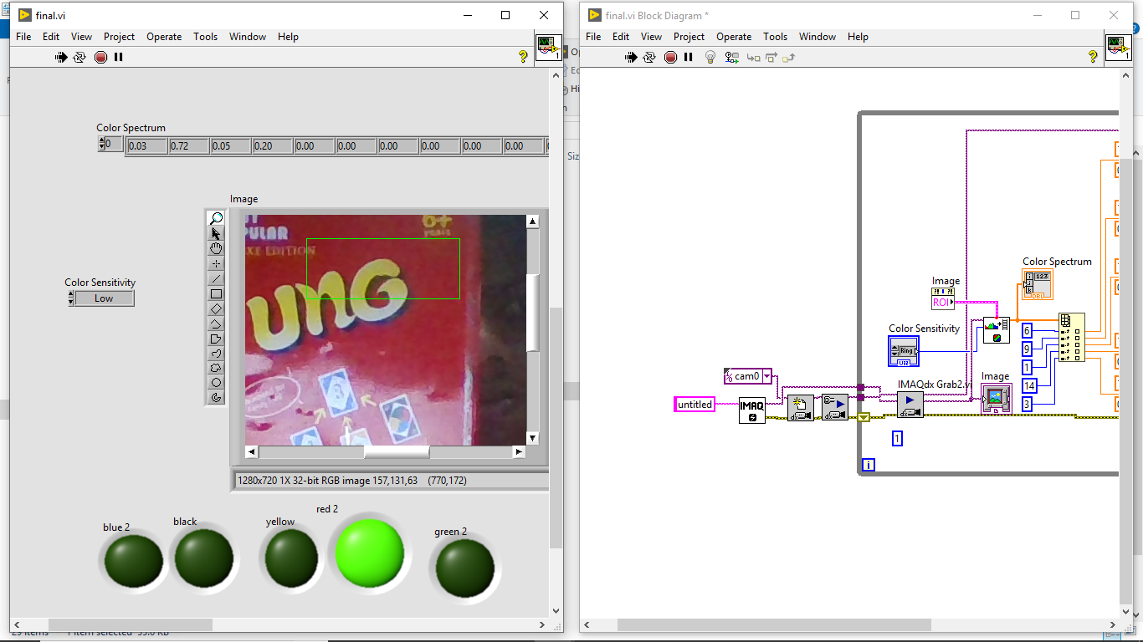
Detecting Red And Led (Red) Is ON

Slide 10
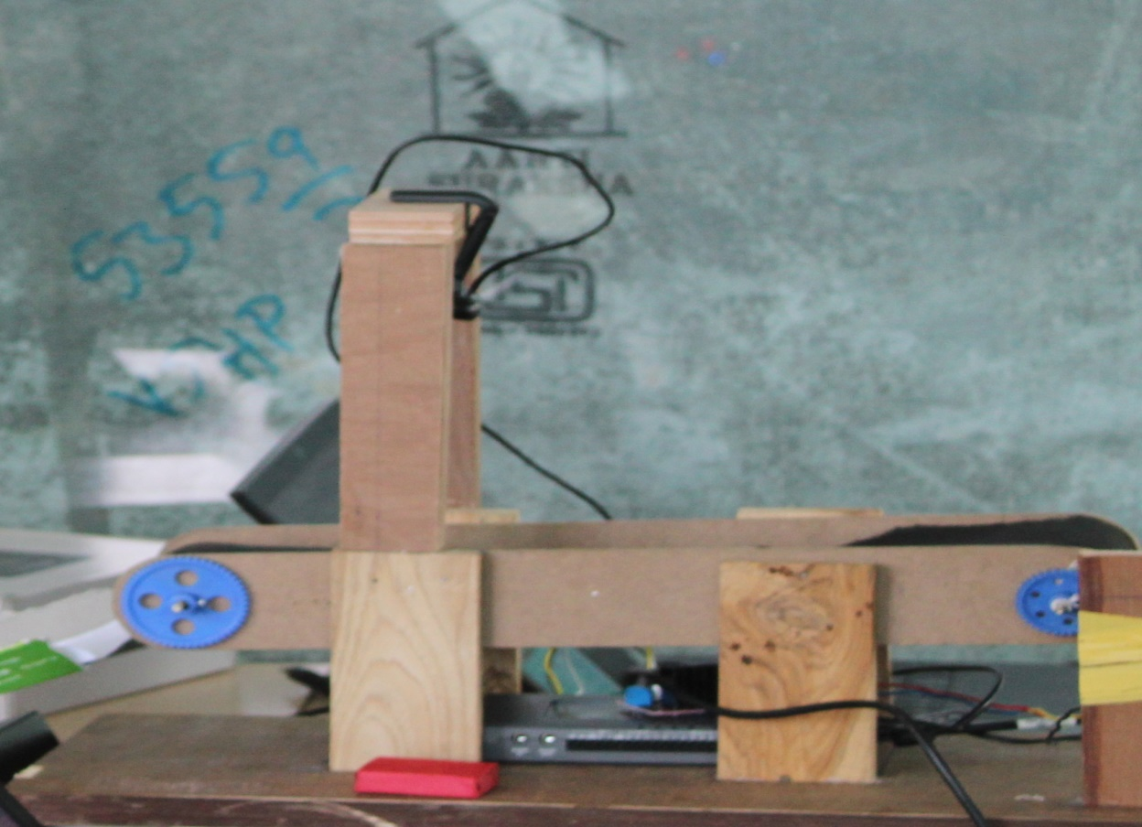
DESIGN AND CONSTRUCTION

Slide 11
Advantages of My rio over aurdino
The myRIO can also use multithreading to have some parallel operations whereas to achieve this on the Arduino is much harder
The FPGA on the myRIO allows you run really high-speed data acquisition much faster than you could perform with the Arduino.
The myRIO is more powerful - it has a faster processor / more memory
The myRIO has more I/O options analogue/digital IO, RS232/SPI/I2C etc.

Slide 12
Applications
The rice sorting industry is the first big market, the rice sorting technology using a high-resolution CCD optical sensor to separate different stones, black rice, etc.
In the recycling industry, colour sorters can distinguish between coloured and colourless objects.
The transparency of the diamond is measured by the colour sorter and used as a measurement of its purity, and the diamonds are mechanically sorted accordingly.

Slide 13
Conclusion
Color sorting is an excellent one because of its working principle and wide implementation. By applying the idea of this project an industry can easily sort the required product according to its color. Though it has some limitations, but by having done some modification this concept can be implemented in wide range of application.

Slide 14
REFERENCES
Lego bricks color sorting machine by Sazly Anuar ; Allya Badzura Baharuddin ; Amirah Mohammad
Design and construction of color sensor based optical sorting machine by Timothy Henry ; Laurence ; Ishak ; Ferry Jie
Multi-color recognition based on neighborhood contrast by Qilin Bi ; Xiaomin Jiang ; Xiaoguang Liu ; Taobo Cheng ; Yulong Zhu ; Miaohui Wang

